Slide 1
Quera intro to quantum Computing with Neutral atoms MIT iQuhack
Pedro Lopes, PhD + Philip Weinberg, PhD

Slide 2
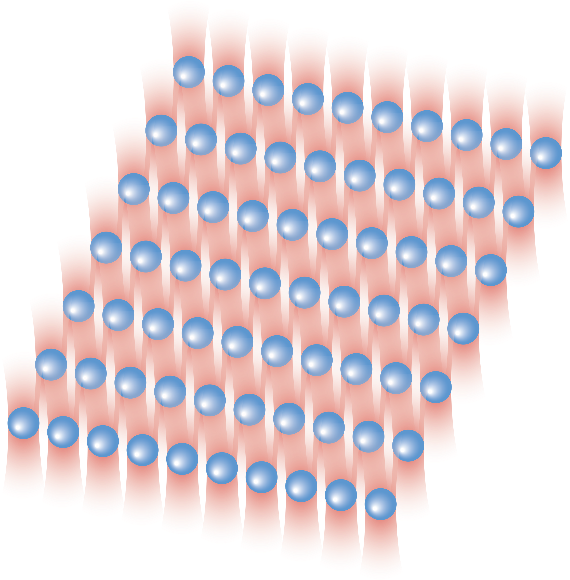
Neutral-atom quantum processor
Densely packed qubits (atoms)
Efficient qubit control
Flexible problem encoding
New ways to think quantum computing!

Slide 3
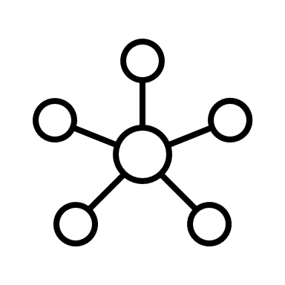
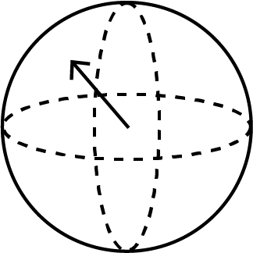

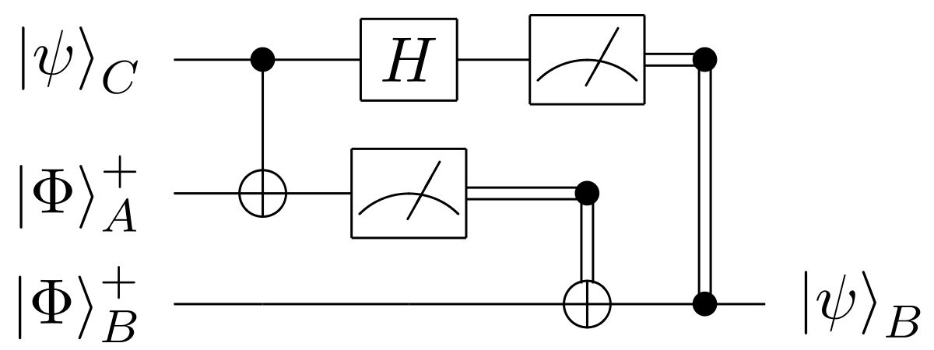
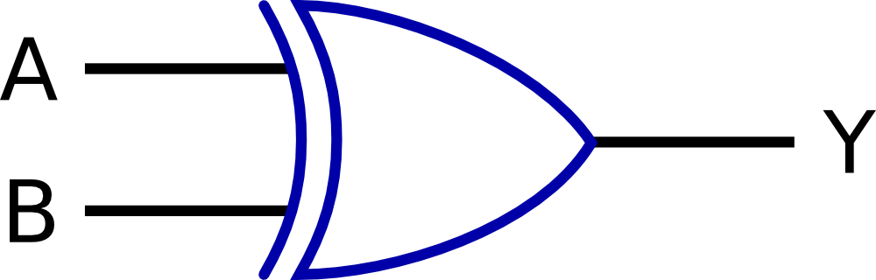

What is quantum computing? => new rules!
Classical
Quantum
Information input
bits
qubits
Information processing
Logic gates
Quantum gates
Results & output
Deterministic
Probabilistic & deterministic

Slide 4
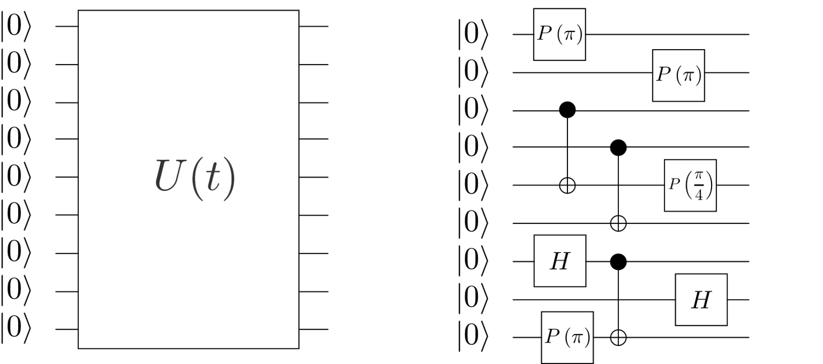


Analog Processing
Analog operation
Digital operation
Designed for the early stage of maturity of the quantum computing resources of today…
Robustness to errors
Easy control
Single-step large entanglement
Universal applicability
More on analog processors:
Nature volume 607, p. 667–676 (2022)

Slide 5
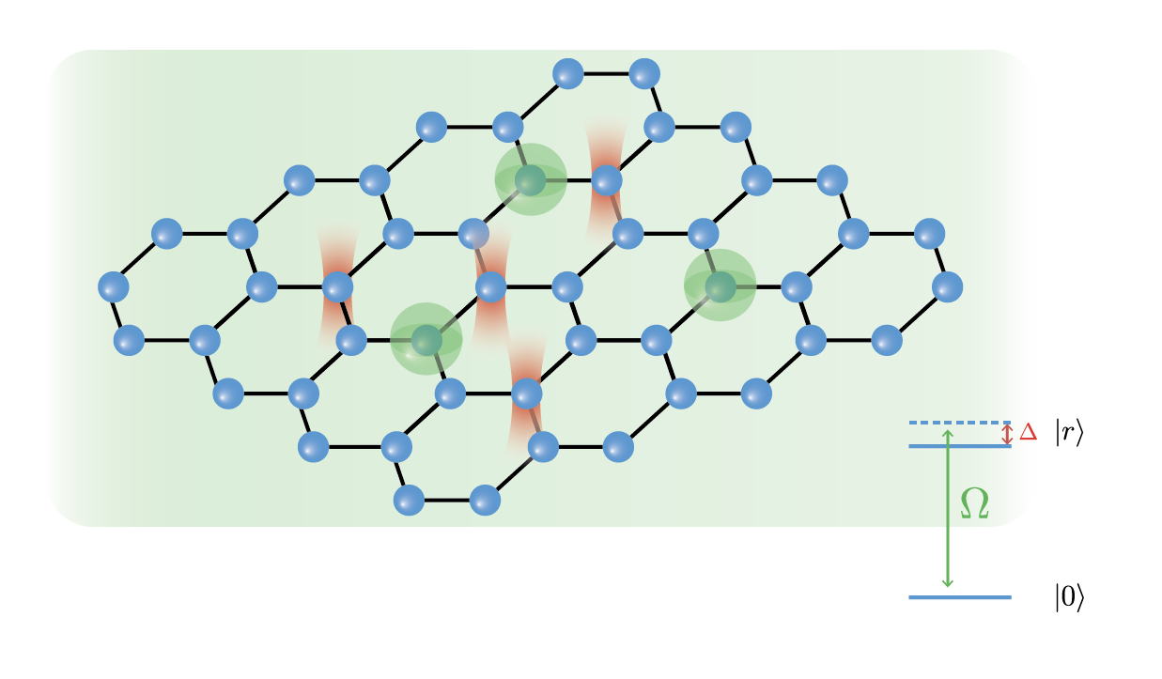
Field Programmable Qubit Arrays (FPQAs)
Analog operation
Designed for the early stage of maturity of the quantum computing resources of today…
Robustness to errors
Easy control
Control qubit positions! Control qubit connectivity!
=> Many possibilities!
Single-step large entanglement
Universal applicability
More on analog processors:
Nature volume 607, p. 667–676 (2022)

Slide 6
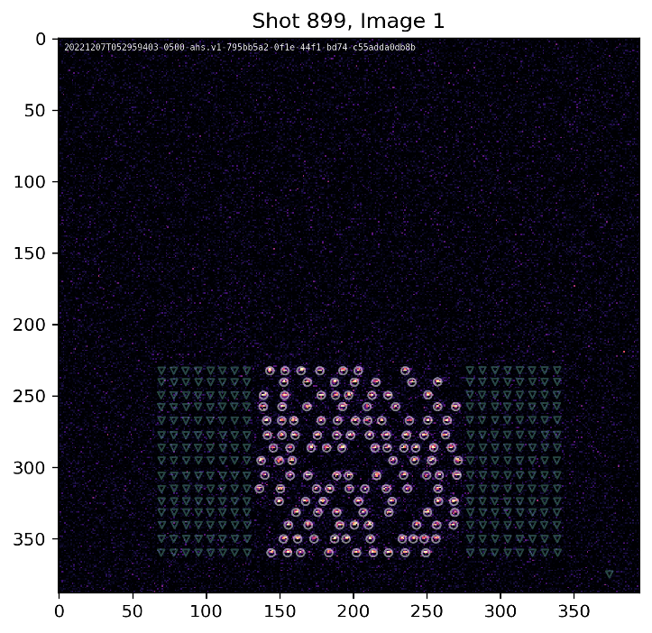
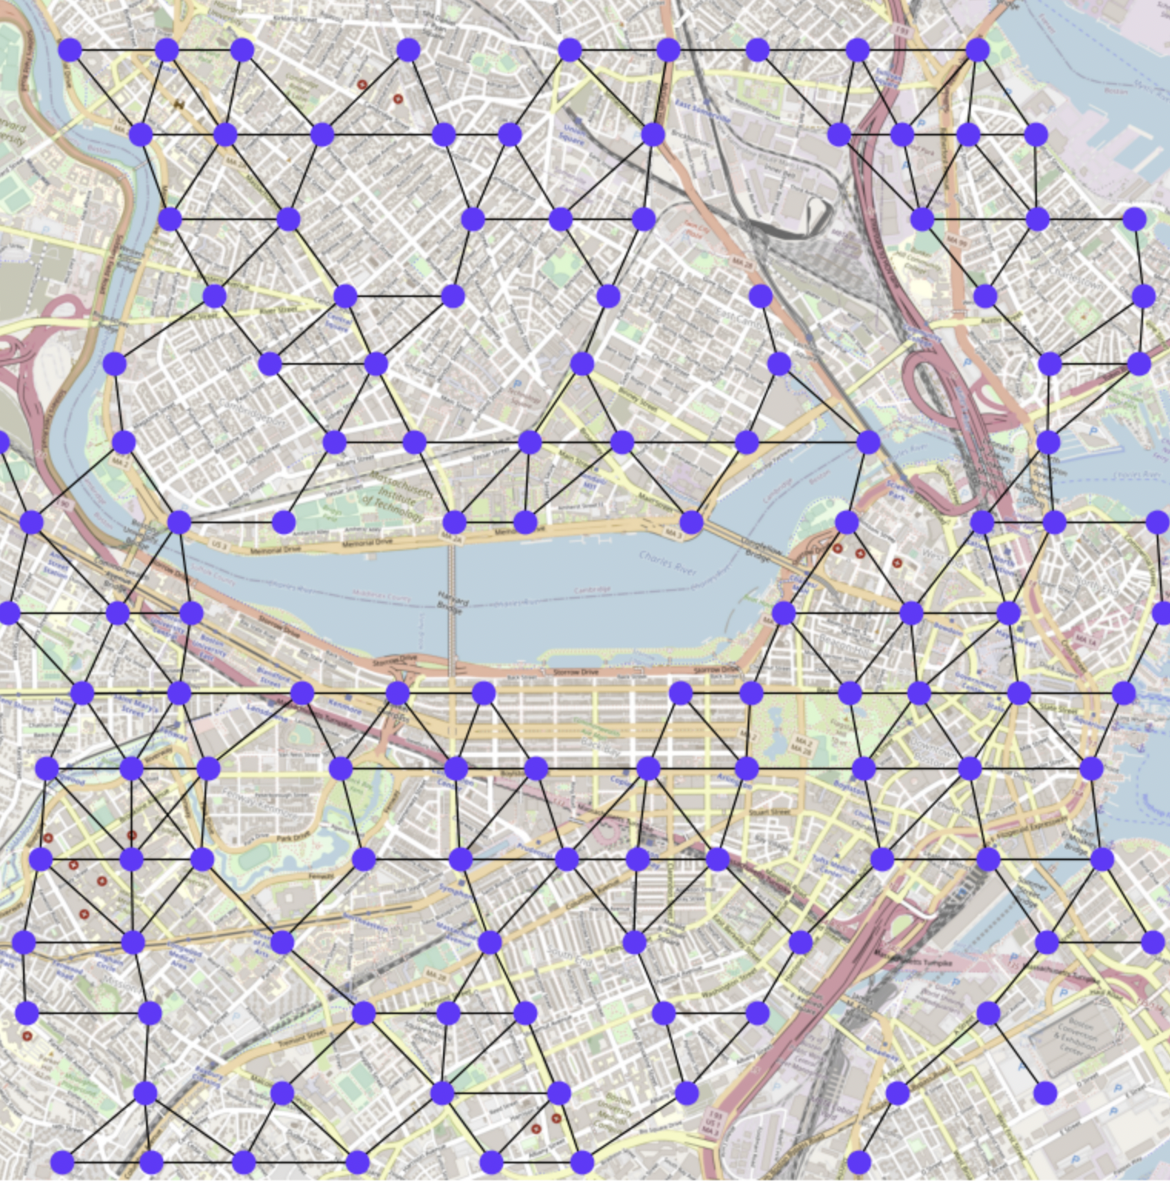
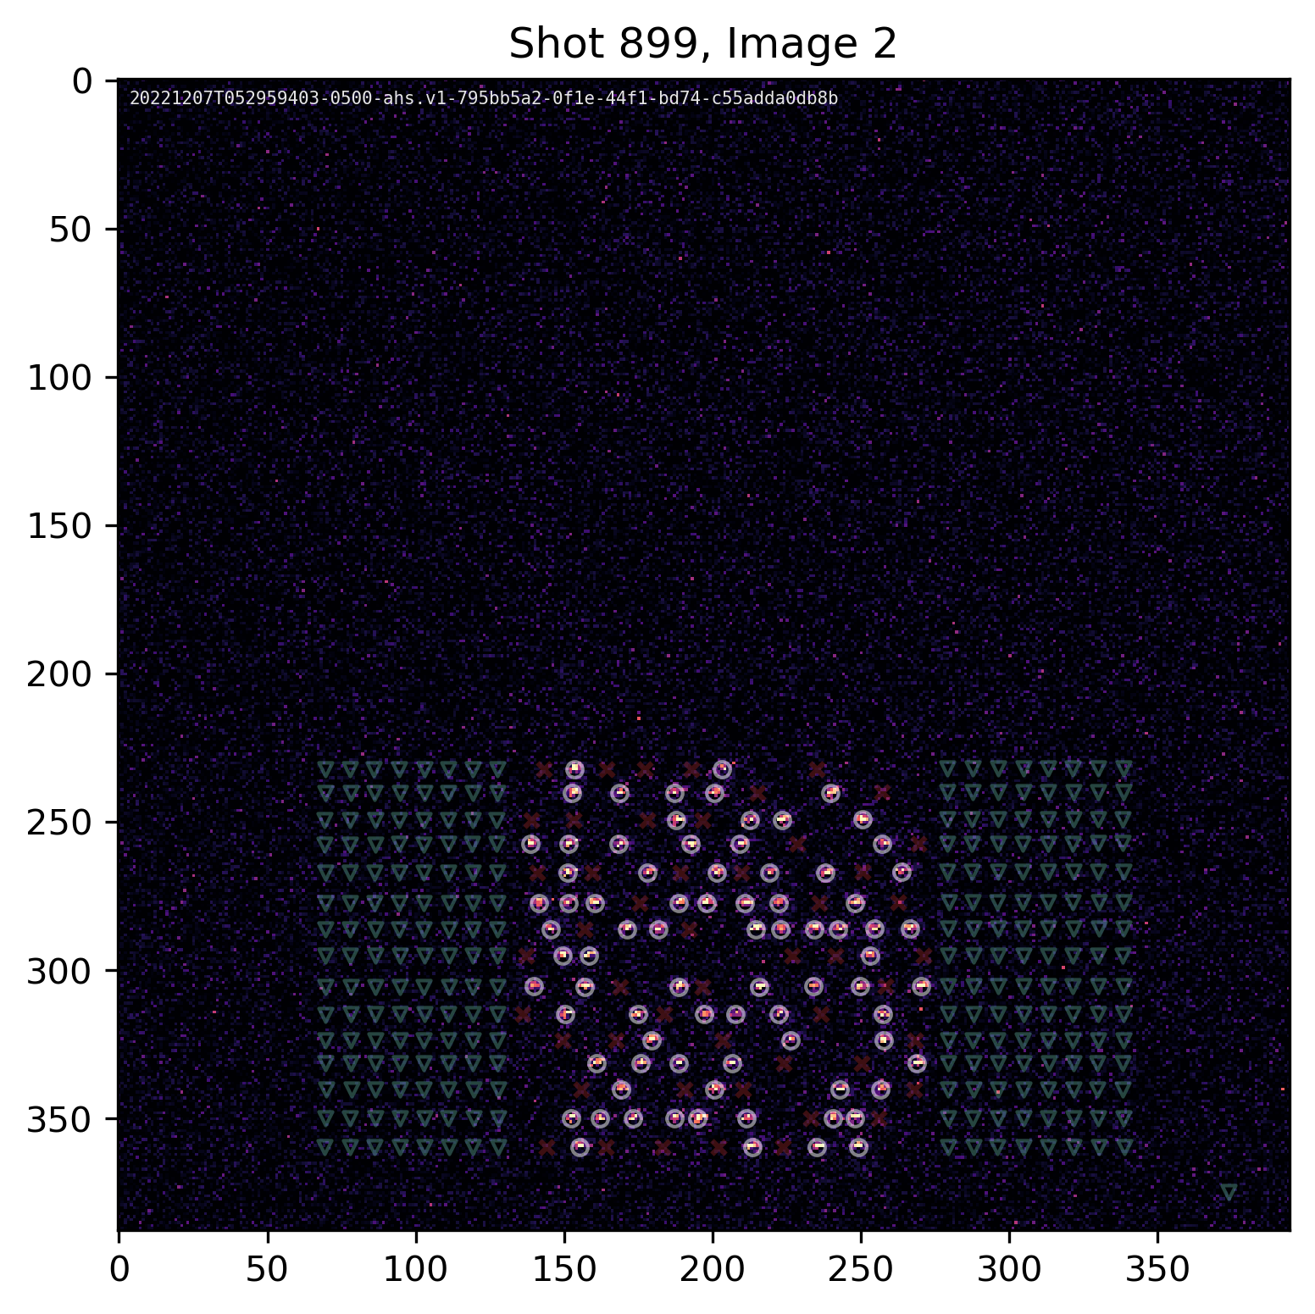
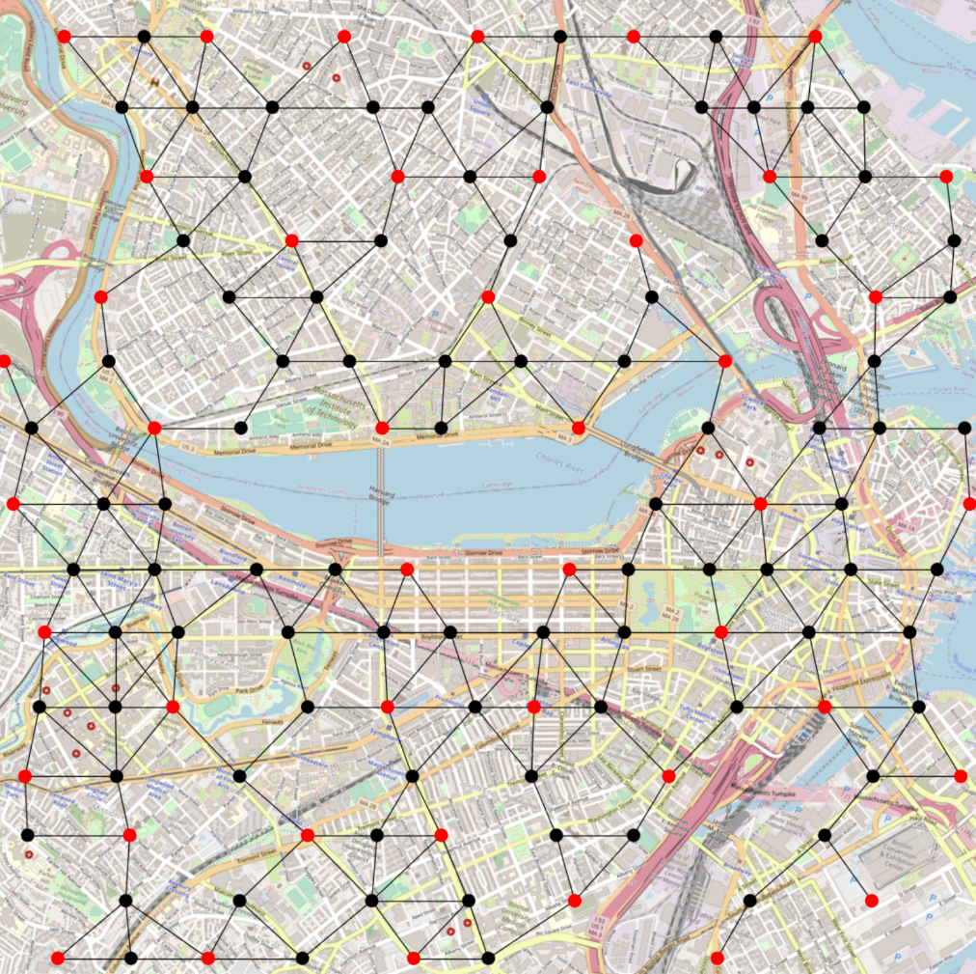
FPQA = Efficient Problem Encoding
Problem: choosing optimal locations in Boston
Possible locations as atom coordinates
Solution
The analog computation provides the optimal solution

Slide 7
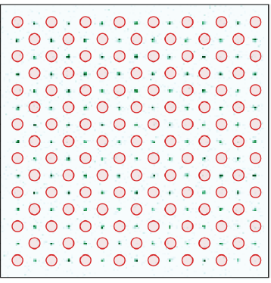
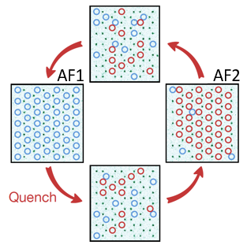
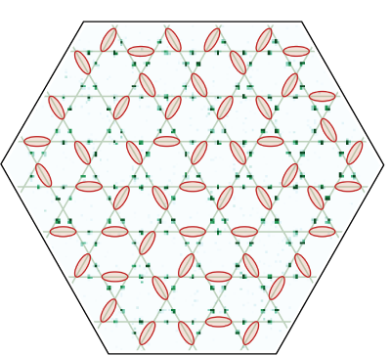
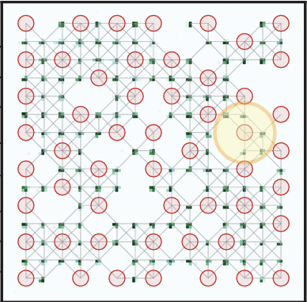


Major victories
Quantum phase transitions and critical dynamics
Controlling quantum many-body scars
Maximum Independent Set Optimization
Quantum spin liquids
Ebadi, et al., Nature,
595, 227 (2021)
Bluvstein, et al., Science,
371, 1355 (2021)
Semeghini, et al., Science,
374, 1242 (2021)
Ebadi, et al., Science,
376, 6598 (2022)
Some of the largest coherent quantum simulations ever
First scientific discovery genuinely led by quantum computers
First realization of a complex quantum phase sought after for 50 years
Quantum scaling demonstration for optimization problems

Slide 8
Qubits = puffed atoms

Slide 9
Algorithm = time evolution
Unitary control = Hamiltonian control

Slide 10
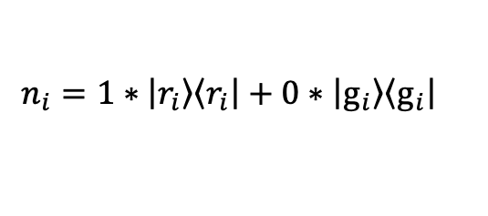
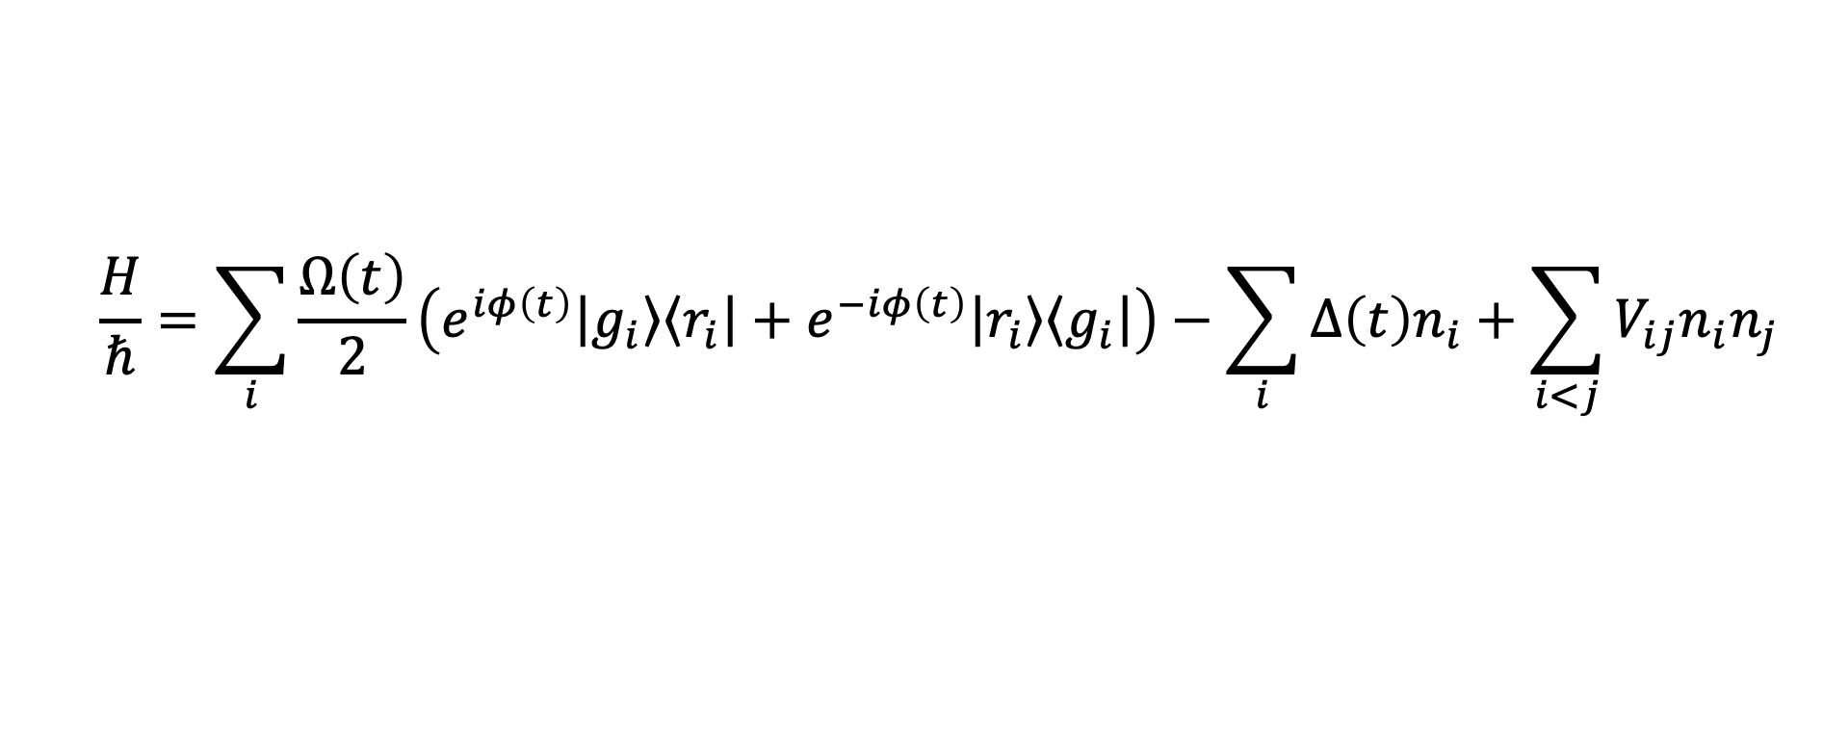
Analog quantum dynamics control
$$\frac{H}{ℏ}=\sum_{i}{\frac{Ω\left(t\right)}{2}\left(e^{iφ\left(t\right)}\left|\left.g_{i}\right\rangle \right.\left\langle \left.r_{i}\right|\right.+e^{−iφ\left(t\right)}\left|\left.r_{i}\right\rangle \right.\left\langle \left.g_{i}\right|\right.\right)−\sum_{i}{∆\left(t\right)n_{i}}+\sum_{i<j}{V_{ij}n_{i}n_{j}}}$$
$$n_{i}=1∗\left|\left.r_{i}\right\rangle \right.\left\langle \left.r_{i}\right|\right.+0∗\left|\left.g_{i}\right\rangle \right.\left\langle \left.g_{i}\right|\right.$$

Slide 11
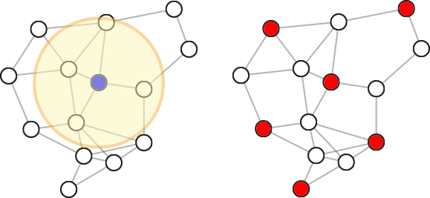
Algorithmic paradigms
State preparation
Quantum dynamics
Quantum simulation
Machine learning
Optimization
Machine Learning
Sampling
Quantum simulation
Ebadi, et al., Nature, 595, 227 (2021)
Bluvstein, et al., Science, 371, 1355 (2021)
Semeghini, et al., Science, 374, 1242 (2021)
Ebadi et. al Science, 376, 6598 (2022)

Slide 12
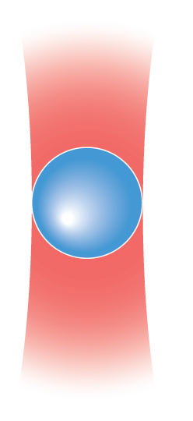
Rydberg blockade: phenomenology

Slide 13
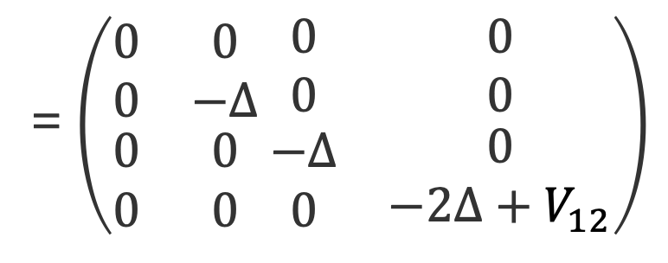
Rydberg blockade radius
$$H=−∆ (n_{1}+n_{2})+V_{12}n_{1}n_{2}$$
= $\left(\begin{matrix}\begin{aligned}0 \\ 0\end{aligned} & \begin{aligned}0 \\ −∆\end{aligned} \\ \begin{aligned}0 \\ 0\end{aligned} & \begin{aligned}0 \\ 0\end{aligned}\end{matrix}\begin{matrix}\begin{aligned} 0 \\ 0\end{aligned} & \begin{aligned}0 \\ 0\end{aligned} \\ \begin{aligned} −∆ \\ 0\end{aligned} & \begin{aligned}0 \\ −2∆+V_{12}\end{aligned}\end{matrix}\right)$
Energy

Slide 14
Rydberg blockade radius
Energy

Slide 15
Rydberg blockade: utility
Maximum
Independent
Set
(NP-Complete)
Adapted from Ebadi et. al Science, 376, 6598 (2022)

Slide 16
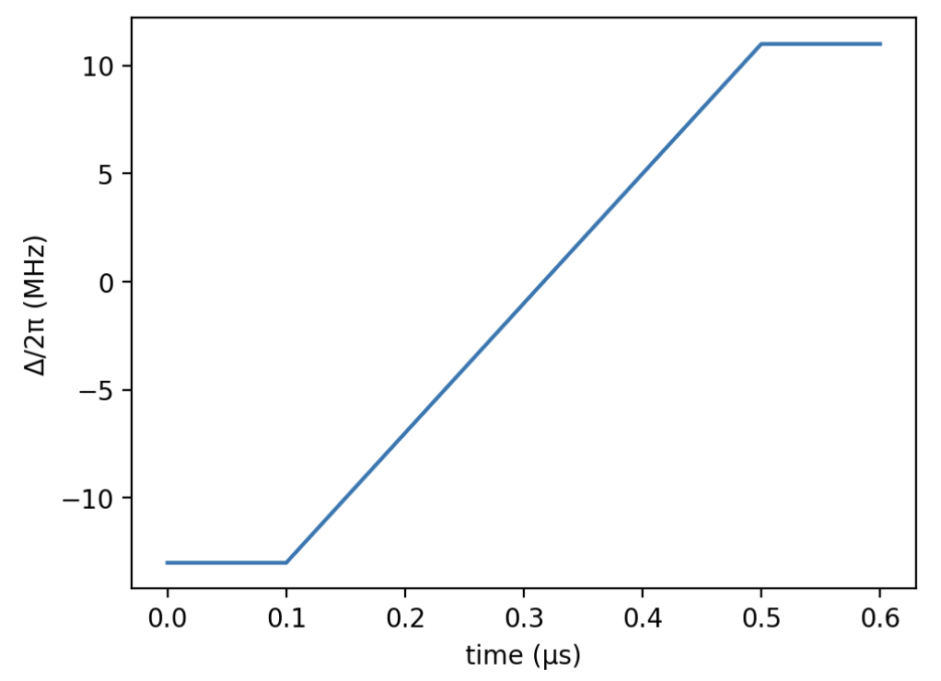
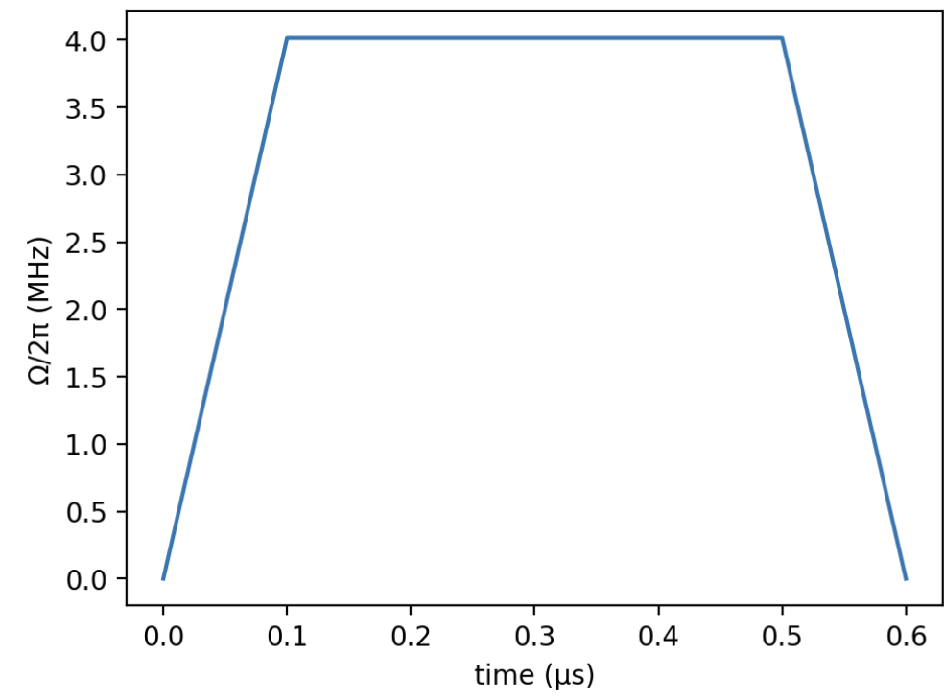
An algorithm for MIS

Slide 17
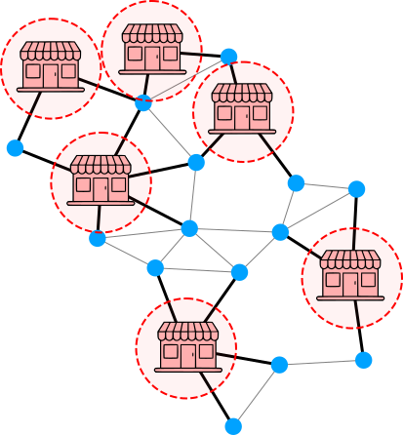
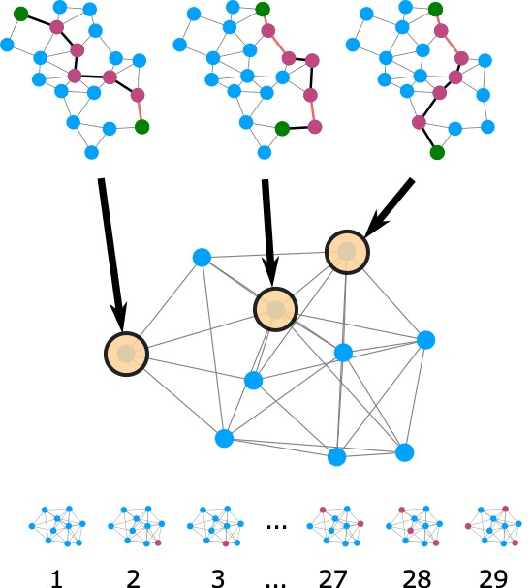
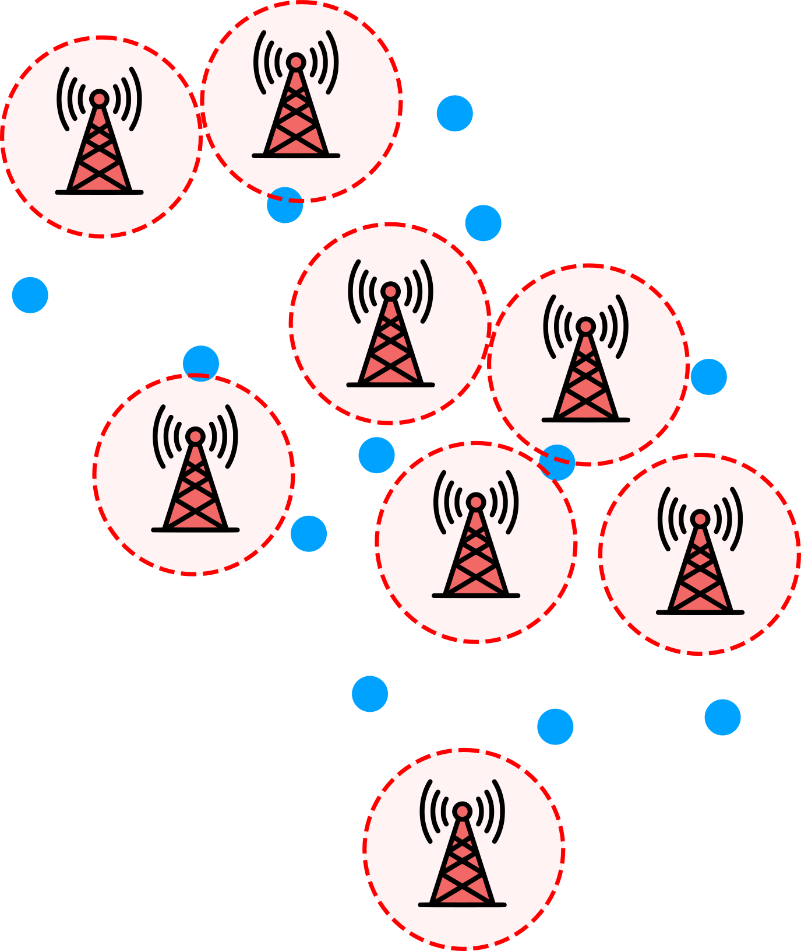
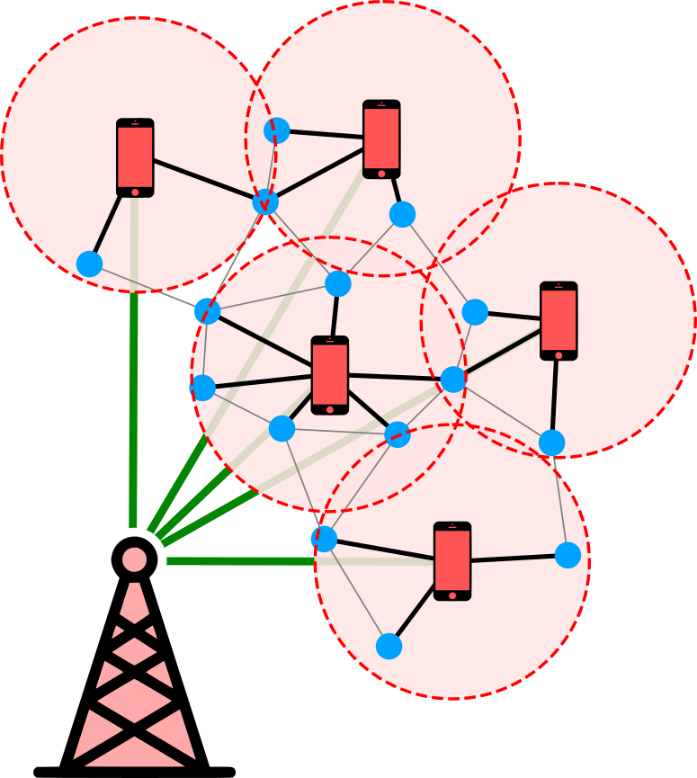
MIS applications are ubiquitous
Wurtz et al., “Industry applications of neutral-aom quantum computing solving independent set problems” https://arxiv.org/abs/2205.08500

Slide 18
Programming neutral atoms in 5 simple steps
Define atom positions => Rydberg radius
Define time traces of Hamiltonian parameters
Initialize Hamiltonian
Evolve!
Measure!

